Slide 1
TRAFFIC SIGN RECOGNITION
DONE BY : G SIVA SANKAR
312321205156
IT C
ST.JOSEPH’S COLLEGE OF ENGINEERING

Slide 2
OBJECTIVES
The main objective of our project is to design and construct a computer-based system which can automatically detect the traffic signs to provide assistance to the user or the machine so that they can take appropriate actions.
The proposed approach consists of building a model using Convolutional Neural Networks by extracting traffic signs from an image using color information.

Slide 3
INTRODUCTION
Nowadays, there is a lot of attention being given to the self driving car. One of the many important aspects for a self-driving car is the ability for it to detect traffic signs in order to provide safety and security for the people not only inside the car but also outside of it.
The traffic environment consists of different aspects whose main purpose is to regulate flow of traffic, make sure each driver is adhering to the rules to provide a safe and secure environment to all the parties concerned.
The proposed approach consists of building a model using Convolutional Neural Networks by extracting traffic signs from an image using color information. We have used convolutional neural networks (CNN) to classify the traffic signs and we used color based segmentation to extract/crop signs from images.

Slide 4
ABSTRACT
Automatic detection and recognition of traffic signs is very important and could potentially be used for driver assistance to reduce accidents and eventually in driver-less automobiles.
In this paper, Deep Convolutional Neural Network (CNN) is used to develop an Autonomous Traffic and Road Sign (ATRS) detection and recognition system.
The proposed system works in real time detecting and recognizing traffic sign images.
The images were taken from different angles and including other parameters and conditions.

Slide 5
PROBLEM STATEMENT
After capturing the image sequences under different conditions (illumination, weather, speeds,etc), using vehicle mounted camera, the following objectives are expected;
Propose of this method to extract the image frames from the image segment.
Propose of this method to remove the effect of the different illuminations on extracted image frames.
Propose of this method to extract the symbol of the traffic sign and identify the symbol of the traffic warning sign

Slide 6
EXISTINTING SYSTEM
Despite the advantages of traffic sign recognition, there are drawbacks. For starters, in more rural areas it is hard to see a traffic sign. Which could mean car can plough into a 30mph zone way above the speed limit, endangering other vechile.
Some vechile have little speed limit stickers on them. Which reports of car thinking these stickers are speed limits – not helped of course if motors are driving too close to the rear of the vechile.
Normally these stickers say what the vechile is limited to, which is fine on a motorway, but if you are in a built-up area, chances are you don’t want your car thinking the speed limit is 60. The worst case here is cars that automatically change to the new speed limit. That said, most cars of the capability will have adaptive cruise control as well, so will know there is a vechile in front and not fly off to 70mph.

Slide 7
PROPOSED SYSTEM
The system we proposed here is sectioned into two phases: Detection and Recognition .
The Detection phase simply discovers a sign from the environment.
When a car moving at a certain speed, the camera captures the environment, and our algorithm checks to see if a sign is present in that frame or not.
Detecting the traffic sign is based on the color and shape.
In the recognition phase, the proposed algorithm classifies the detected sign.
This is archived with the help of Convolutional Neural Network ensemble.

Slide 8
ADVANTAGES OF PROPOSED SYSTEM
It’s reduces the signal records.
Maintain all the signal records.
It reduces the man power.

Slide 9
DATASETS
The dataset contains lots of images of different traffic signs. It is further classified into 43 different classes. The dataset is quite varying, some of the classes have many images while some classes have few images. The size of the dataset is around 300 MB. The dataset has a train folder which contains images inside each class and a test folder which we will use for testing our model.
ALGORITHM: CNNs –CONVOLUTION NEUTRAL NETWORK

Slide 10
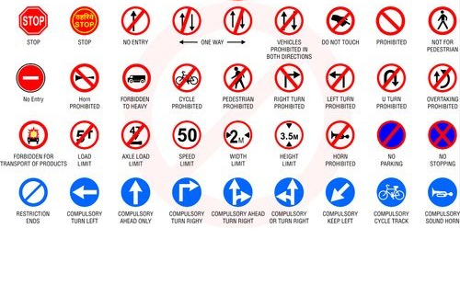

Slide 11
ARCHITECTURE DIAGRAM
Input image
Extraction of Region Interest
(ROI)
Processing of Region
Road Traffic Sign Labelling
Classification
Feature Extraction Using CNN

Slide 12
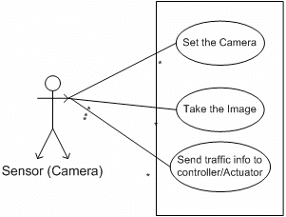
USE CASE DIAGRAM

Slide 13
CNN-CONVOLUTIONAL NEURAL NETWORK
CNN has the greater capabilities for image pattern recognition and are widely used in Computer Vision and Convolutional Neural Network (CNN).
CNN is one of the neural network models for deep learning, which has three specific characteristics, firstly it takes locally connected neurons, secondly, it calculates shared weight and finally gives the spatial or temporal sub-sampling. Generally, CNN is compromised of two main parts .The first contains alternating Convolutional and second is the max pooling layers. The input of each layer is just the output of its previous layer. As a result, this forms a hierarchical feature extractor that maps the original input images into feature vectors. Then the second part classifies the extracted features vectors, that is, the fully-connected layers, which is a typical feed-forward neural network.

Slide 14
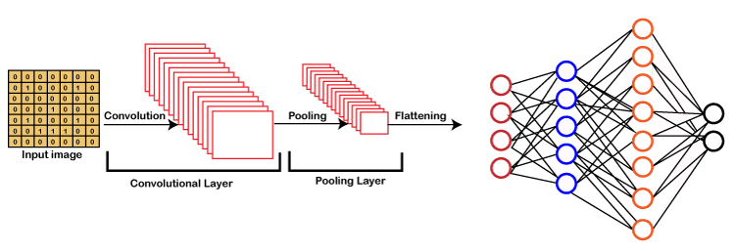
CONVOLUTION NEURAL NETWORK-CNN

Slide 15
SOFTWARE/HARDWARE REQUIREMENTS
Processor-Intel Pentium i v -2.0B HZ,M1
Hardisk-40GB
RAM -4GB is sufficient
Python IDE & Python package for ML.

Slide 16
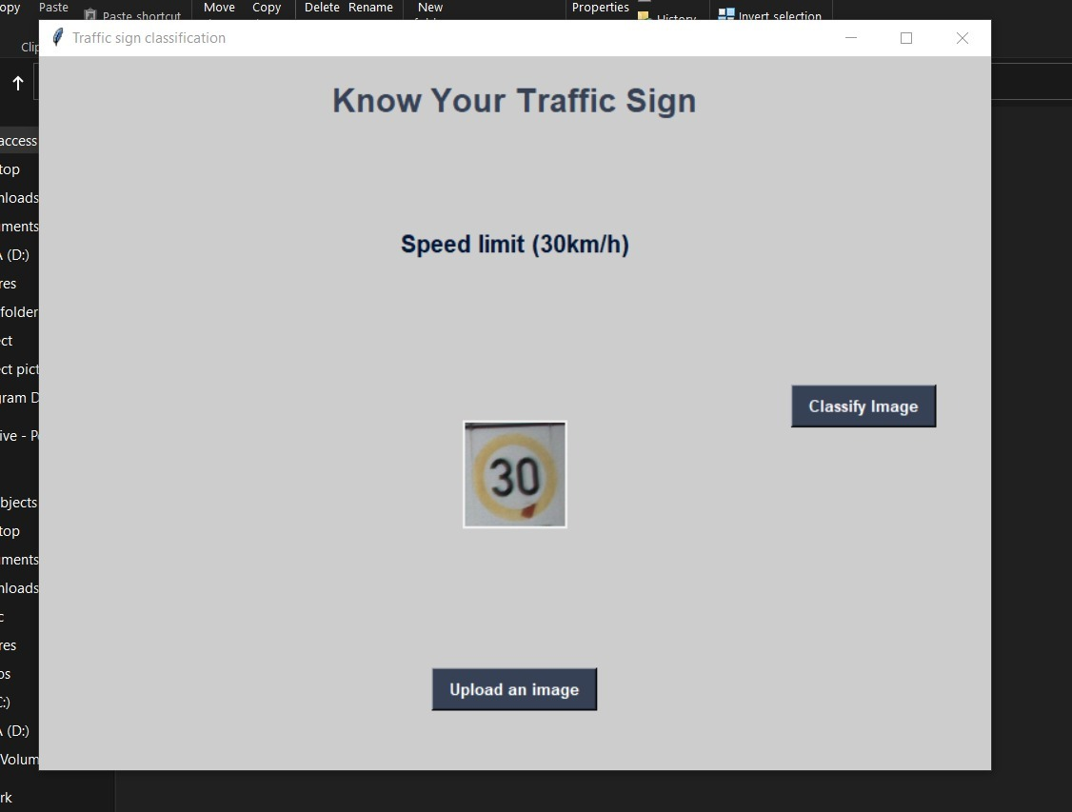
OUTPUT SCREENSHOT

Slide 17
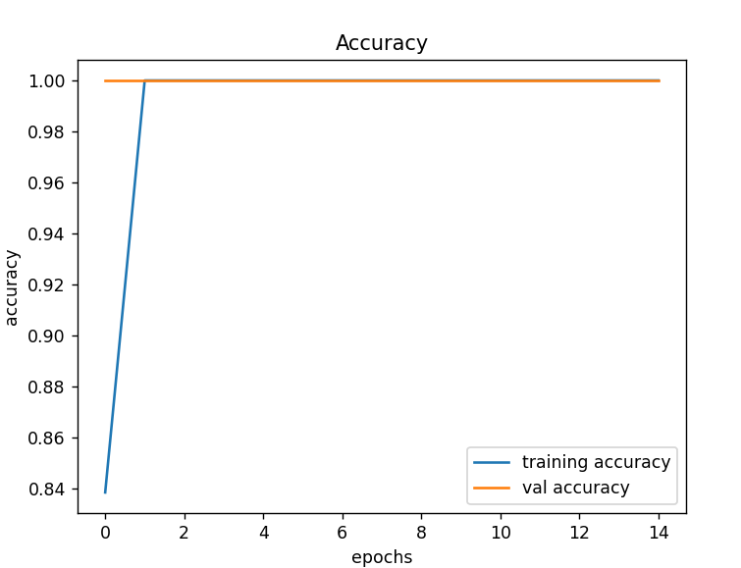
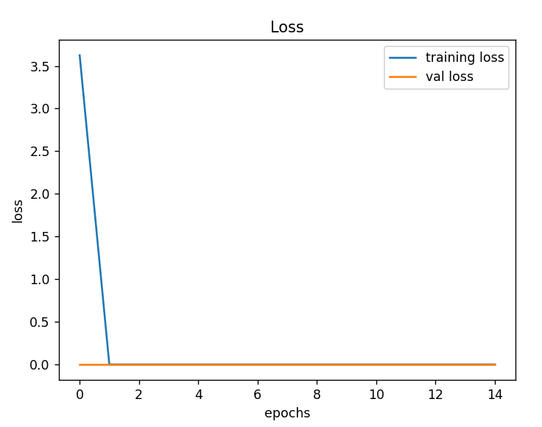
GRAPH AND ACCURACY

Slide 18
CONCLUSION
In this, we created a CNN model to identify traffic signs and classify them with 95% accuracy. We had observed the accuracy and loss changes over a large dataset. GUI of this model makes it easy to understand how signs are classified into several classes.
The experimental results show that the accurate recognition rate of traffic signs reaches 99.75%, and the average processing time per frame is 5.4 ms.
The proposed algorithm has more admirable accuracy, better real-time performance, stronger generalization ability and higher training efficiency than other algorithms

Slide 19
FUTURE ENHANCEMENT
In future work, we want to tackle a number of challenges for further improvement in computational speed and the recognition accuracy.
In this respect, we are planning to address the following issues: The incorporation of scene and motion modeling, in combination with projective geometry, can both reduce the computational cost and detection errors.
Experiments have shown inferior performance for the detection and classification of objects, the size of which is not exactly covered by one of the detectors.

Slide 20
REFERENCE
[1] Shustanov A and Yakimov P 2017 CNN Design for Real-Time Traffic Sign Recognition Procedia Engineering 201 718-725
[2] Ruta A, Porikli F, Watanabe S and Li Y 2011 In-vehicle camera traffic sign detection and recognition Mach Vis Appl. 22 359-375 DOI: 10.1007/s00138-009-0231-x
[3] Belaroussi R, Foucher P, Tarel J-P, Soheilian B, Charbonnier P and Paparoditis N 2010 Road Sign Detection in Images: A Case Study Pattern Recognition 20th International Conference ICPR 484-488
[4] Koesdwiady A, Soua R and Karray F 2016 Improving Traffic Flow Prediction with Weather Information in Connected Cars: A Deep Learning Approach IEEE Trans Veh Technol. 9508- 9517

Slide 21
[5] Yakimov P Y 2015 Tracking traffic signs in video sequences based on a vehicle velocity Computer Optics 39(5) 795-800
[6] Houben S, Stallkamp J, Salmen J, Schlipsing M and Igel C 2013 Detection of traffic signs in real-world images: The German traffic sign detection benchmark Proceedings of the International Joint Conference on Neural Networks 715-722
[7] Sermanet P and LeCun Y 2011 Traffic sign recognition with multi-scale Convolutional Networks Neural Networks The International Joint Conference (IJCNN)
[8] Hinton G E, Sabour S, Frosst N 2017 Dynamic Routing Between Capsules Proceedings of the 30th Conference on Neural Information Processing Systems (NIPS

Slide 22
THANK YOU

